Slide 1
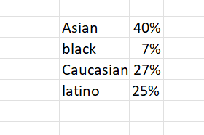
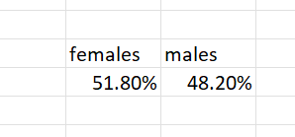
Ques.1
The gender and ethnicity distribution is as follows.

Slide 2
Ques.2

Slide 3
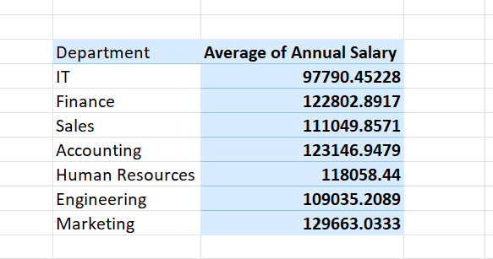
Ques 3
The difference is as mentioned. It seems there is not much difference.

Slide 4
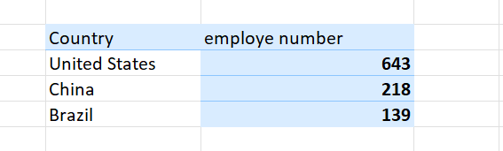
Ques.4
USA has highest number of employees.

Slide 5
Ques.5

Slide 6
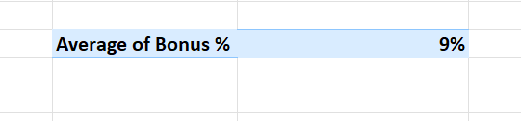
Ques.6
The average is as stated. 8.86%(approx.)

Slide 7

Ques.7
This is the most frequent job title.

Slide 8
Ques.8

Slide 9
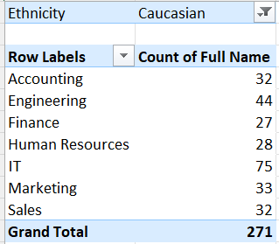
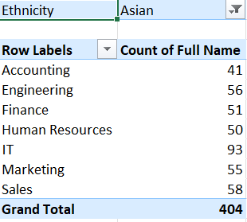
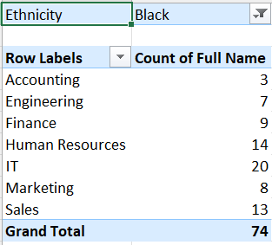
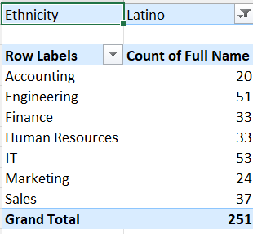
Ques.9
Caucasians and Chinese are more in IT department

Slide 10
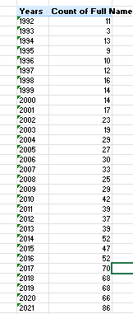
Ques.10
It seems that hiring has increased in the past few years, being 86, 66, 68 in the last 3 years.

